Slide 1
Customer Lifetime Value Analysis
By Garima Nirala

Slide 2
What is Customer Lifetime Value Analysis
Customer Lifetime Value (CLV) analysis is a business metric and data-driven strategy used to understand and predict the total value a customer is likely to bring to a company throughout their entire relationship with that company. By analyzing customer lifetime value , companies can identify the most effective marketing channels and campaigns for acquiring high-value customers and develop targeted retention strategies to keep customers.
Python is used for conducting out this analysis here ,because of its extensive data analysis and machine learning libraries. It provides a wide range of libraries for CLV analysis process, and data visualization with Matplotlib, Seaborn, or Plotly. By using these tools and techniques, businesses can gain insights into their customer base and make informed decisions to optimize customer relationships and increase profitability.

Slide 3
Objectives of the project
Providing visualization for the distribution of Customer Acquisition Cost and Revenue generated by customer.
Comparing the cost of acquisition across various channels and determining which ones are the most and least profitable.
Determining which channels are most and least effective at converting customers.
Calculating the total revenue by channel and analysing the most and least profitable channels in terms of generating revenue.
And lastly calculating the return of investment(ROI) for each channel.

Slide 4
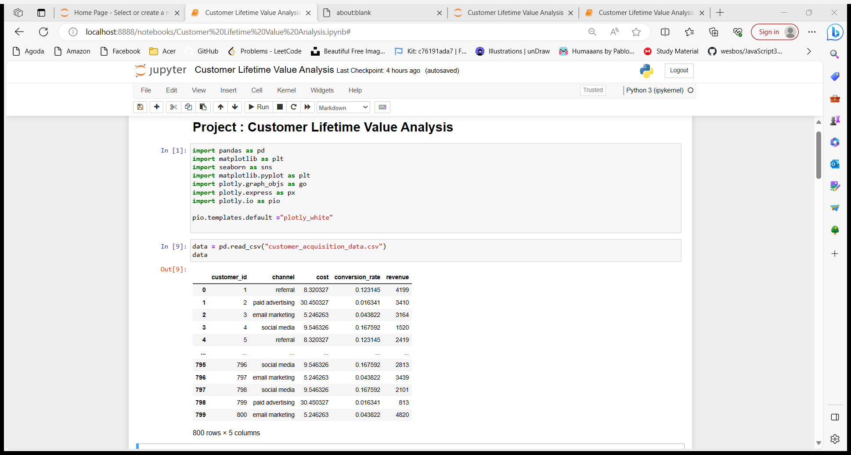
We have used this customer acquisition dataset and imported various libraries for data manipulation and visualization.

Slide 5
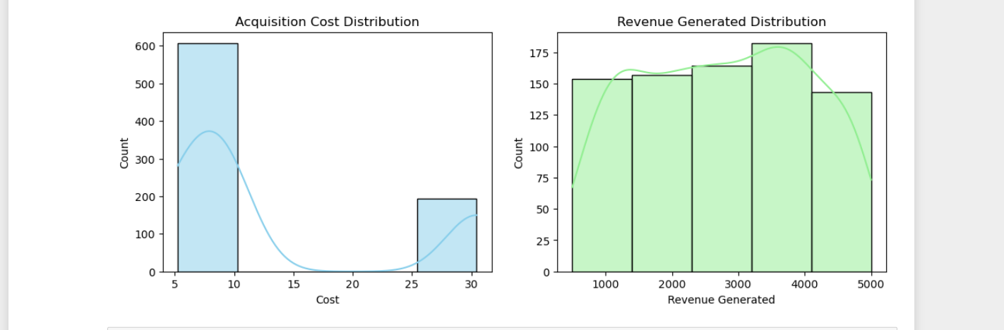
Visualization of the distribution for acquisition cost and revenue generated by the customer using histograms from seaborne library.

Slide 6
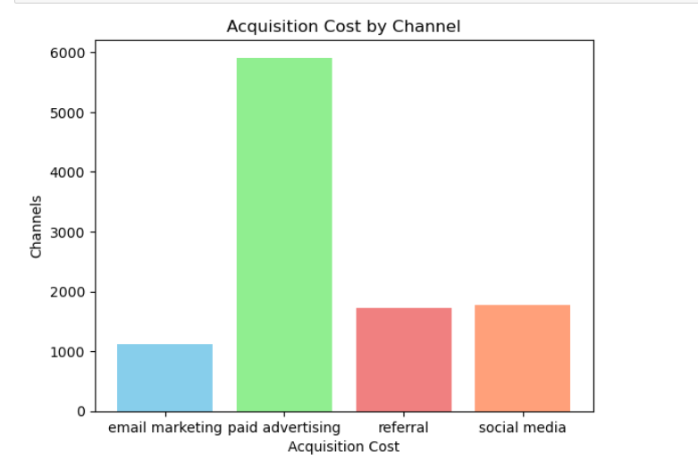
Acquisition Cost by Channel:
"Paid Advertising" stands out with the highest acquisition cost, suggesting the need for businesses to carefully assess the ROI associated with this channel. It's essential to ensure that the expenses align with the expected benefits.
"Email Marketing" shines as a cost-effective method for acquiring new customers. It offers an excellent balance between cost and results, making it a highly recommended channel for customer acquisition.
Notes:
The acquisition cost through various channels, is a metric that helps businesses determine the cost associated with acquiring new customers through different marketing channels and strategies and as on the graph “paid advertising “has the highest acquisition cost and “email marketing is the cost effective method.

Slide 7
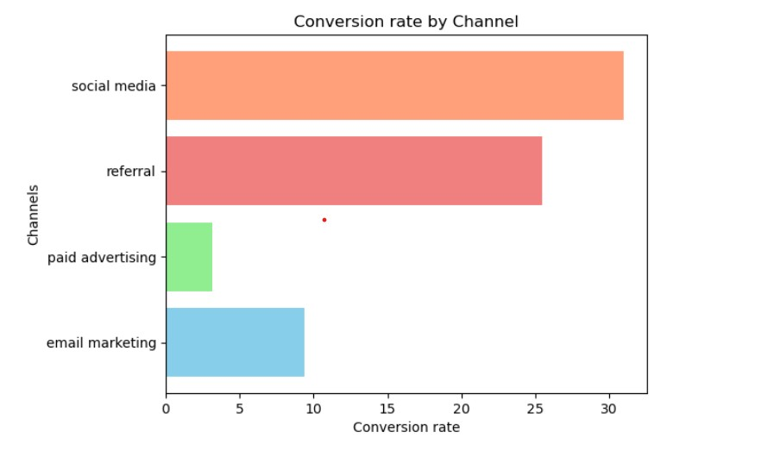
Conversion Rate by Channel:
"Social Media" boasts the highest conversion rate, indicating that it's effective in converting visitors into customers. Businesses should consider leveraging social media strategies for improved customer conversion.
"Referral" follows closely, demonstrating the power of customer recommendations. Encouraging referrals and creating referral programs can be a lucrative strategy.
"Email Marketing" maintains a competitive conversion rate, showcasing its effectiveness in engaging and converting prospects into customers.
Notes:
Conversion rate refers to the percentage of people who take a desired action, such as making a purchase, signing up for a newsletter, or filling out a contact form, out of the total number of people who visited a particular channel , and as seen on the graph “social media has the highest conversion rate followed by “referral” and then “email marketing”.

Slide 8
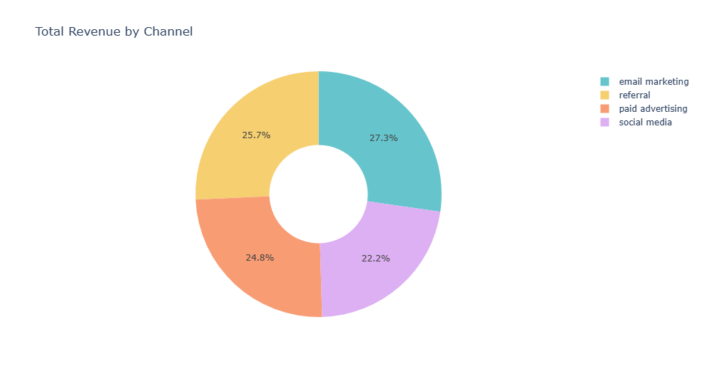
Total Revenue by Channel:
"Email Marketing" emerges as the most profitable channel for generating revenue. Businesses should prioritize email marketing strategies and invest in list building, personalized content, and email automation to capitalize on this high revenue channel.
"Referral" shows promise as the second-highest revenue generator. Companies can enhance their referral programs to boost revenue further.
Notes:
Total revenue by channel helps businesses make informed decisions about resource allocation, marketing strategies, and overall profitability and as seen on the pie chart “email marketing” is the most profitable channel in generating revenue followed by “referral”.

Slide 9
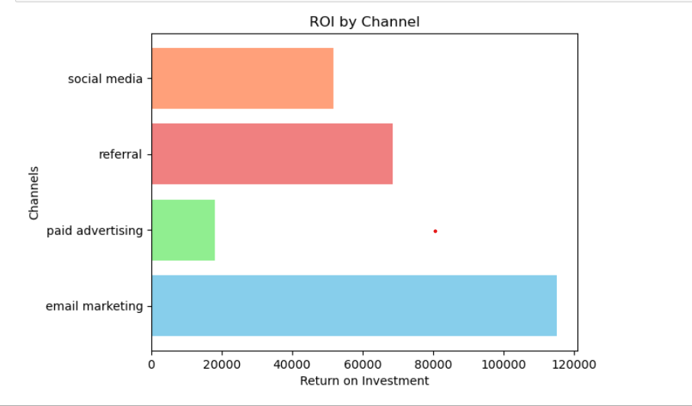
ROI by Channel:
"Email Marketing" consistently yields higher returns, reflecting its efficiency in cost-effective marketing and sales efforts. Businesses should continue to invest in and refine their email marketing campaigns.
"Referral" also demonstrates a strong ROI, making it an attractive channel for investment.
Notes:
ROI analysis considers both the revenue generated and the costs associated with each channel. A higher ROI suggests cost-efficient marketing or sales efforts and as seen “email marketing” yields higher returns followed by referral

Slide 10
Recommendations
Focus on Email Marketing: Given its strong performance in both cost-effectiveness and revenue generation, businesses should prioritize and invest in email marketing. Creating engaging, personalized email campaigns can be a winning strategy.
Leverage Social Media: Channels with high conversion rates, such as social media, deserve attention. Investing in targeted social media campaigns can lead to a higher customer conversion rate.
Enhance Referral Programs: Building and improving referral programs can help businesses increase both customer acquisition and revenue. Encouraging satisfied customers to refer friends and colleagues can be a powerful growth strategy.
Continuous Monitoring: It's essential to continually monitor and adjust marketing strategies based on changing customer behaviors and market dynamics. Regularly reviewing and optimizing these channels is crucial for sustained success.

Slide 11
Thank you

